Slide 1
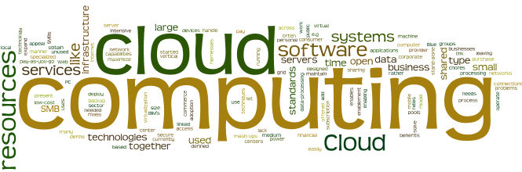
Software Defined Architecture

Slide 2
Module Objectives
You should able to answer below questions end of this module.
What is Software defined Data center and its core components ?

Slide 3
Software Defined Datacenter (SDDC)
Software-defined data center (SDDC) is the phrase used to refer to a data center where all infrastructure is virtualized and delivered as a service and each component potentially provisioned, operated, and managed through an application programming interface
Control of the data center is fully automated by software, meaning hardware configuration is maintained through intelligent software systems
Notes:
Dell PowerFlex

Slide 4
Software Defined Datacenter: Core Architecture Components
Computer virtualization
Software-defined networking (SDN)
Software-defined storage (SDS)
Management and Automation

Slide 5
Software Defined Compute
Compute is data center jargon meaning “CPU and memory resources.”
Software defined compute, then, is the practice of controlling and automating abstracted compute resources. In most cases, that would mean manipulating virtual machine workloads.

Slide 6
Software Defined Network
Software Defined Networking (SDN) is an evolutionary approach to network design based on the ability to programmatically modify the behavior of network devices.
SDN is a framework to allow network administrators to automatically and dynamically manage and control a large number of network devices, services, topology, traffic paths, and packet handling (quality of service) policies using high-level languages and APIs
Create a logically-centralized network controller that communicates with both applications and forwarding nodes, and will be responsible for implementing application needs at the network’s composite nodes and reporting information back to the applications
Essentially a network operating system (NOS)
Notes:
Cisco Meraki
Dell SDN Solutions
Junos
Cradlepoint NEtCloud

Slide 7
Software Defined Network: Benefits
Virtualization
Orchestration
Programmability
Dynamic Scaling
Visibility
Automation:
Troubleshooting
Reduce downtime
Policy enforcement
Notes:
Orchestration is the process of managing a set of automated tasks to create an entire workflow. A sysadmin sets up a system to perform a series of jobs based on a specific set of rules and parameters. Orchestration can involve the configuration, coordination, and management of multiple:
Computer systems.
Technologies.
Apps.
Datasets.
Middleware.
In orchestration, the person designing the process dictates the desired result. However, the computer can make decisions based on changing circumstances. This capability makes orchestration significantly more complex than task automation. An orchestrated system can:
Make decisions based on varying factors.
React to different events.
Keep track across various IT environments (apps, mobile devices, databases, etc.).
-----
In simple terms, network visibility refers to having an awareness of all the different components at work within your network to be able to analyze the following aspects: Performance. Traffic. Big data analytics
-----
Automation enables you to set up a single process to run without human involvement. Instead of a staff member performing a task by hand, a computer can follow a script and reliably perform a task quickly and as many times as necessary.
In automation, the sysadmin has already made all task-related decisions. A computer only executes a "recipe" of instructions and fulfills a single goal.
Automation makes time-intensive processes more efficient and reliable. A business can automate various repetitive tasks both on-premises and in the cloud, including:
Provisioning a virtual server when there is a spike in traffic or usage.
Transferring customer data from a CRM.
Launching a web or app server.
Sending a PDF to a customer after a user submits an online form.
Integrating a software API.
Deploying security measures on an endpoint if an Intrusion Detection System (IDS) discovers a threat.
Sending info to a third-party app (e.g., a ticketing system).
Changing a line of code in all JSON or YAML files.
Sending an automatic email based on different stages of a marketing funnel.
Adding a record to a database at the start of a batch jo

Slide 8
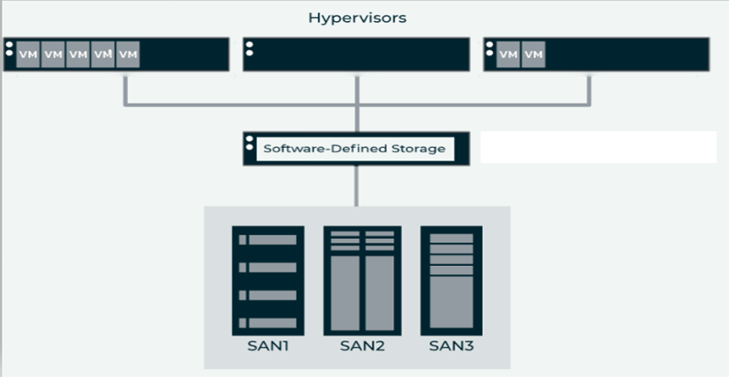
Software Defined Storage (SDS)
Generally accepted definition is that software defined storage is “where the management and intelligence of the storage system is decoupled from the underlying physical hardware.”
This means that the SDS software is then able to provide policy-based management and provisioning of the data being stored, regardless of the storage hardware that’s being used.

Slide 9
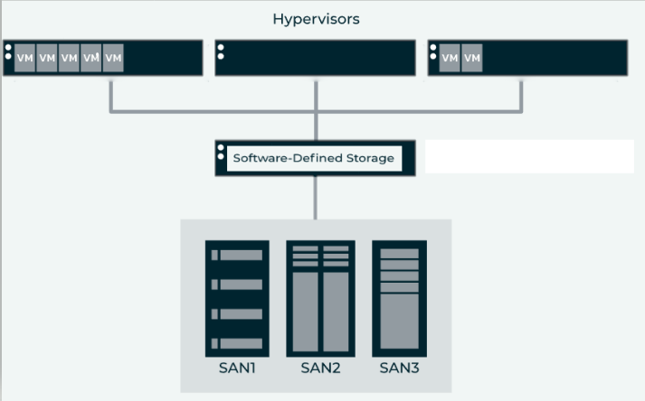
Software Defined Storage (SDS) (Cont. 2)
Most SDS systems create a file system overlay on top of the physical hardware. That file system is then utilized by virtualization hosts (to store virtual machines) or by physical servers — both of which provide application services.
SDS may be sold separately from the underlying storage, or it may be included with the underlying storage
The SDS storage system is typically distributed across the multiple physical hosts that provide the actual physical storage capacity. The distribution offers both high availability for the data (in the event of failure) as well as performance (by having multiple copies of the data available). That physical storage capacity can be a mix of traditional spinning disk or flash storage
Notes:
Vmware vSAN
Pure Storage
HP HPE storage Solutions

Slide 10
Software Defined Storage (SDS) (Cont. 3)
Some possible data services to include are:
Thin provisioning
In virtual storage, thick provisioning is a type of storage allocation in which the amount of storage capacity on a disk is pre-allocated on physical storage at the time the disk is created. Thick provisioning contrasts with thin provisioning, which provisions storage on an as-needed basis
Deduplication
Deduplication and is defined as optimizing data storage by eliminating duplicate copies of data. An example of deduplication is to remove multiple copies of the same file that are stored in a database in multiple locations.
Compression
Data compression is the process of modifying, encoding or converting the bits structure of data in such a way that it consumes less space on disk. It enables reducing the storage size of one or more data instances or elements. Data compression is also known as source coding or bit-rate reduction.

Slide 11
Software Defined Storage (SDS) (Cont. 4)
Some possible data services to include are:
Cloning
Cloning creates an exact, uncompressed replica of your storage. If your hard drive fails, you could remove it and replace it with the cloned drive(s).
Replication ( windows solution for disaster recovery)
A storage replication service is a managed service in which stored or archived data is duplicated in real time over a storage area network (SAN). Other terms for this type of service include file replication, data replication, and remote storage replication
Snapshotting
A snapshot is a point-in-time copy of data created from a set of markers pointing to stored data and is effectively a backup. Snapshots provide a variety of approaches that can supplement backup and provide rapidly accessible copies to which is it possible to roll back.
Notes:
With a snapshot, nothing significant happens on the collection of hard drives where the protected entity resides. The storage system merely takes note that the way the protected entity looks at that moment means it needs preserving. The difference between copy-on-write and redirect-on-write snapshots is how they store the previous version of a modified block, and these two methods have serious performance ramifications.
Consider a copy-on-write system, which copies any blocks before they are overwritten with new information (i.e. it copies on writes). In other words, if a block in a protected entity is to be modified, the system will copy that block to a separate snapshot area before it is overwritten with the new information. This approach requires three I/O operations for each write: one read and two writes. Prior to overwriting a block, its previous value must be read and then written to a different location, followed by the write of the new information. If a process attempts to read the snapshot at some point in the future, it accesses it through the snapshot system that knows which blocks changed since the snapshot was taken. If a block has not been modified, the snapshot system will read that block from the original protected entity. If it has been modified, the snapshot system knows where the previous version of that block is stored and will read it from there. This decision process for each block also comes with some computational overhead.
A redirect-on-write system uses pointers to represent all protected entities. If a block needs modification, the storage system merely redirects the pointer for that block to another block and writes the data there (i.e. it redirects on writes). The snapshot system knows where all of the blocks are that comprise a given snapshot; in other words, it has a list of pointers and knows the location of the blocks those pointers are referring to. If a process attempts to access a given snapshot, it simply uses these pointers to access those blocks where they originally resided. The fact that some of those blocks were replaced and are now represented by other pointers is irrelevant to the snapshot process. There is zero computational overhead of reading a snapshot in a redirect-on-write system.

Slide 12
Software Defined Datacenter vs (Private) Cloud
Software-defined is an approach to design that enables the infrastructure to be managed via API’s. It is comprised of different building blocks such as software-defined storage (SDS), software-defined networking (SDN), compute virtualization and related services. It’s an abstraction of the data center’s infrastructure.
According to the NIST definition of cloud, it’s a service that is on demand, has broad network access, incorporates resource pooling, has rapid elasticity and is a measured service. (Private) cloud is a service that could either replicate a traditional infrastructure or provide virtualized instances of infrastructure components

Slide 13
Access to Cloud : REST vs SOAP
SOAP : Simple Object Access Protocol
Standards-based Web services access protocol allows distributes elements of applications that has been around for a while ( develop by MS) .SOAP can be carried over a variety of lower-level protocols, including the web-related Hypertext Transfer Protocol (HTTP).
It is an XML-based messaging protocol for exchanging information among computers. SOAP is an application of the XML specification.
REST: Representational State Transfer
It is architectural style for distributed hypermedia systems. REST is the newer solution. It seeks to fix the problems with SOAP and provide a truly simple method of accessing Web service

Slide 14
Access to Cloud : REST vs SOAP (cont.)
SOAP advantages Language, platform, and transport independent (REST requires use of HTTP) Works well in distributed enterprise environments (REST assumes direct point-to-point communication) Standardized Provides significant pre-build extensibility in the form of the WS* standards Built-in error handling Automation when used with certain language products | REST Advantages No expensive tools require to interact with the Web service Smaller learning curve Efficient (SOAP uses XML for all messages, REST can use smaller message formats) Fast (no extensive processing required) Closer to other Web technologies in design philosophy

Slide 15
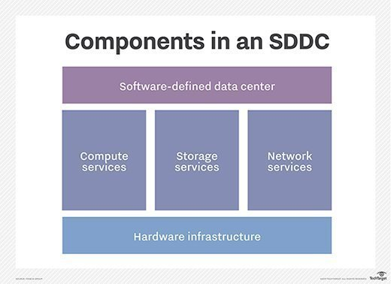
Module Summary
When we decide to use any Software Defined Solutions we must be aware of;
Cloud-compatibility
Integration-readiness SDN solutions do not work as a standalone tool or an appliance.
Data and analytics.
Support
Notes:
Cloud-compatibility Most modern IT environments are heterogeneous in nature. This means that a combination of private and public clouds co-exists with on-premise servers and containers. The SDN solution you choose must be able to support the entire cloud environment. Applications hosted on-premise and on the cloud must be able to run on your software-defined network with adequate monitoring and governance. Ideally, the SDN console should be hosted on the cloud for easy access.
Integration-readiness SDN solutions do not work as a standalone tool or an appliance. They must mandatorily connect with the rest of your enterprise stack, including network components, business applications, and IT monitoring tools. The primary purpose of SDN is to provide you with consolidated visibility into network operations and granular control over performance. Therefore, the SDN solution you choose should support integrations via application programming interfaces (APIs) and prebuilt connectors.
Data and analytics The ability to view network performance data and derive analytics insights is one of the key benefits of SDN. By connecting with your applications, network switches, and traffic gateways, SDN reveals key information about resource utilization in the enterprise. You can also detect network bottlenecks before they become a problem. You may also investigate network anomalies to hunt threats and obtain security intelligence. Therefore, your SDN solution should be able to provide you with real-time dashboards and on-demand network reports.
Programmability When a system is programmable, you can feed it instructions through software code to automate its processes. A programmable SDN solution allows you to set up automated workflows based on specific performance parameters. For example, you can permit or deny traffic depending on the security policies. The SDN solution may come with a command-line interface (CLI) or a graphical user interface (GUI) to write the automation code.
Support Finally, the SDN solution provider should be able to support your network transformation journey from end to end. Depending on your current state of maturity, you may or may not require consultancy and advisory services. But ensure that your SDN partner offers telephonic and on-site help. It should also provide training sessions and resources for ongoing support. Ideally, the provider or one of their partners should have an office in your region.

